Slide 1
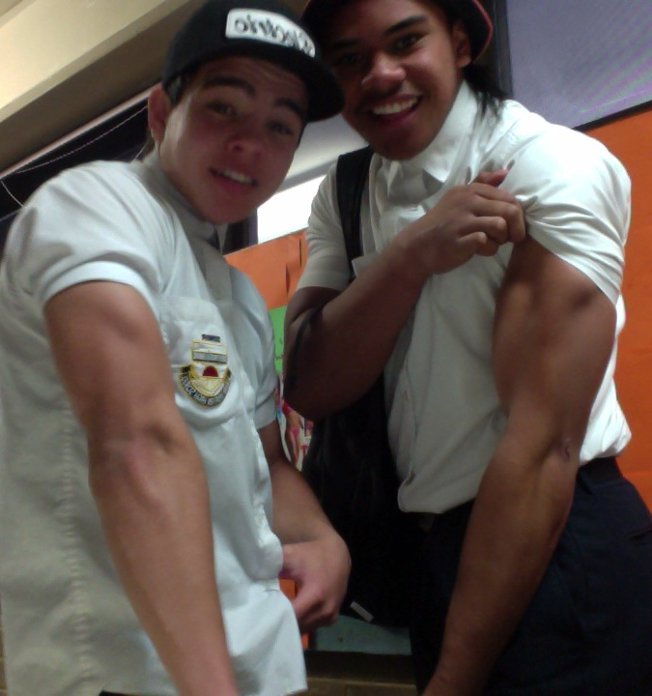
So you think you know …
MUSCLES?

Slide 2
Things to know…
Major muscles for movement – location, origin & insertion [Page 140-142]
Antagonist vs Agonist [Page 143]
Joint movements [135-136]
Types of Contractions [Page 144]

Slide 3
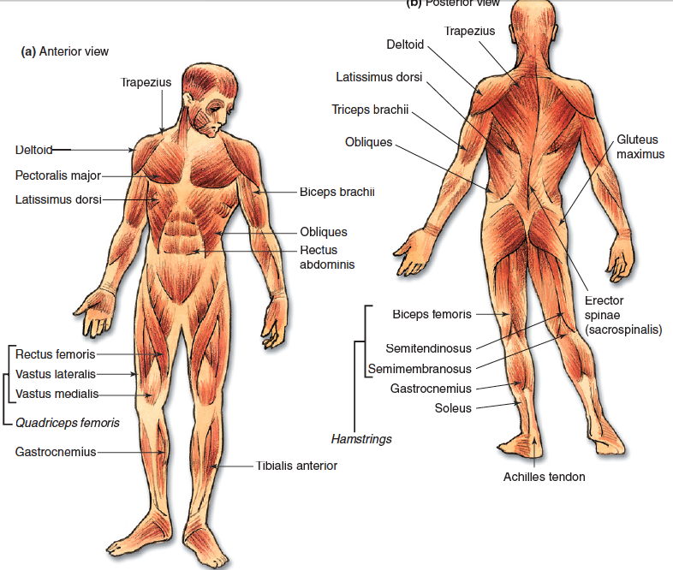

Slide 4
Key words
Origin and insertion of muscles
The origin is the end of a muscle which is attached to a fixed bone.
The insertion is the end of the muscle that is attached to the bone which moves.

Slide 5
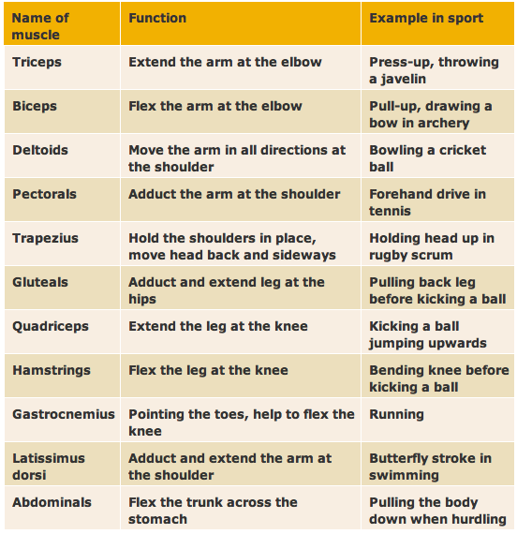
Joint Movements & Sport Contexts

Slide 6
Antagonist vs Agonist
http://www.youtube.com/watchv=rAz2Pam73e0
Know your definitions
Agonist: The agonist or prime mover is the muscle causing the major action.
Antagonist: An antagonist is a muscle that must relax and lengthen to allow the agonist to contract, thus helping to control an action. The agonist works as a pair with the antagonist muscle. The two roles are interchangeable depending on the direction of the movement.
Fixator/Stabiliser: stabiliser or fixator muscle act at a joint to stabilise giving the muscles a fixed base.
Synergist: A muscle which aids the action of a prime mover (a muscle which has the main responsibility for a particular movement). The synergist may produce the same movement as the prime mover, or it may stabilize the joints across which the prime mover acts, preventing undesirable movements

Slide 7
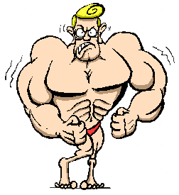
For the following exercises
Name the:
Agonist
Antagonist
Stabiliser

Slide 8
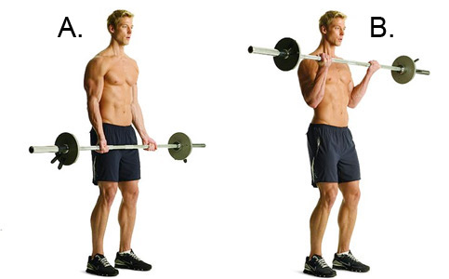
Barbell Curl

Slide 9
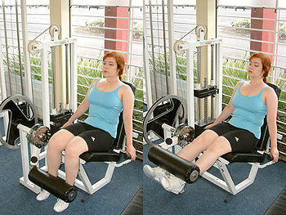
Leg Extension

Slide 10
Types of Contractions
Concentric – during this contraction, the muscle shortens, causing the movement at the joint
Eccentric – contraction occurs while the muscle lengthens under tension
Isometric- contraction occurs when the muscle fibres are activated and develop force, but the muscle length does not change; that is, movement does not occur.

Slide 11
How to study PE
http://www.youtube.com/watch?v=fmnwMQCht-8
http://quizlet.com/11921506/muscular-system-flash-cards/

